Slide 1
HMT 801 Travel Agency and Tour Operations
UNIT 5
Travel Bodies and Association
Topic
History, aims and role of UNWTO
Course Outcome (CO)
CO5: Evaluate the Sustainability of Travel operations and activities of travel bodies and associations

Slide 2
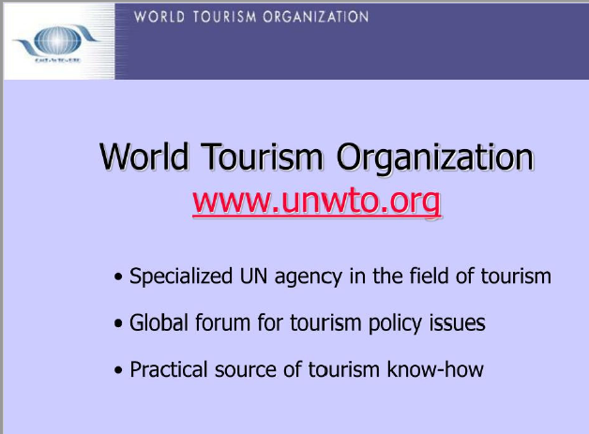

Slide 3
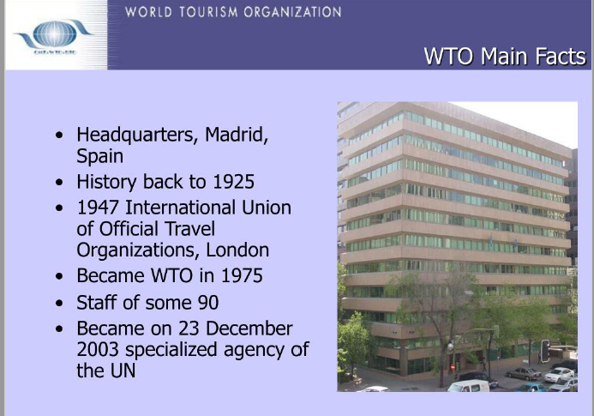

Slide 4
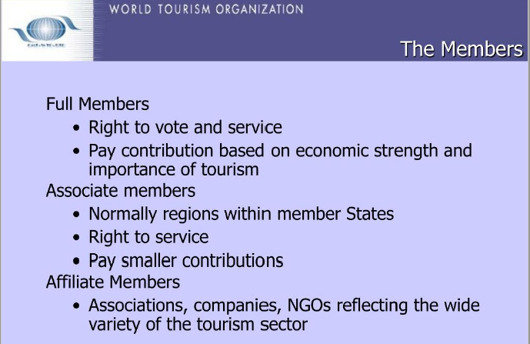

Slide 5
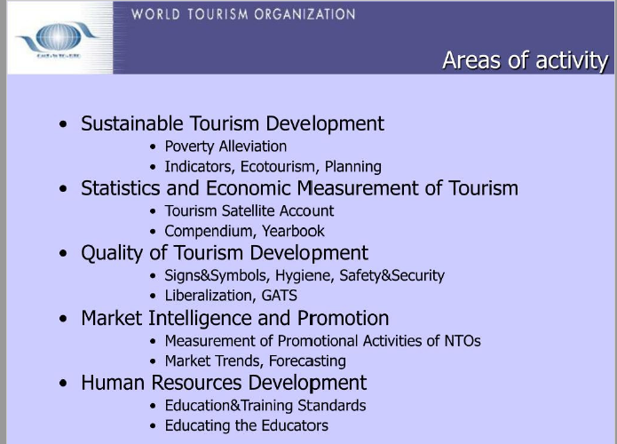

Slide 6
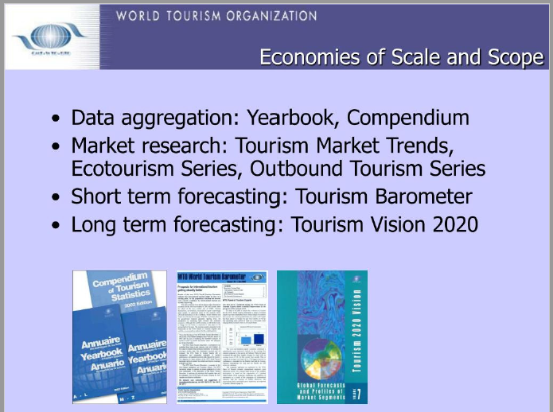

Slide 7
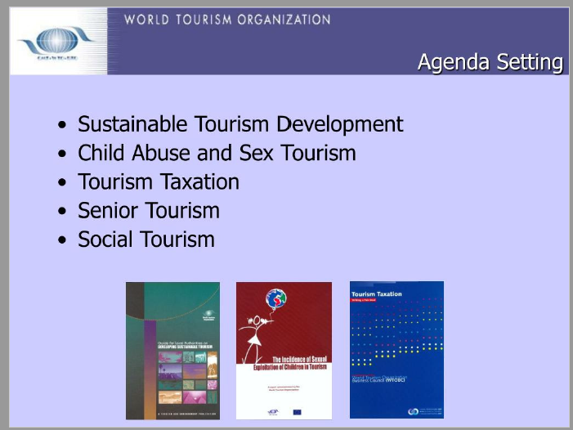

Slide 8


